Slide 1
Traffic Sign Recognition
- Maria Anson.A

Slide 2
Self Driving Cars
Self-driving vehicles are cars or trucks in which human drivers are never required to take control to safely operate the vehicle.
Also known as autonomous or “driverless” cars, they combine sensors and software to control, navigate, and drive the vehicle.
So to make the vehicle autonomous one of the vital part is traffic sign detection which will done by the use of camera in the vehicle
The traffic sign is detected and the respective command is send to the actuators present in the vehicle

Slide 3
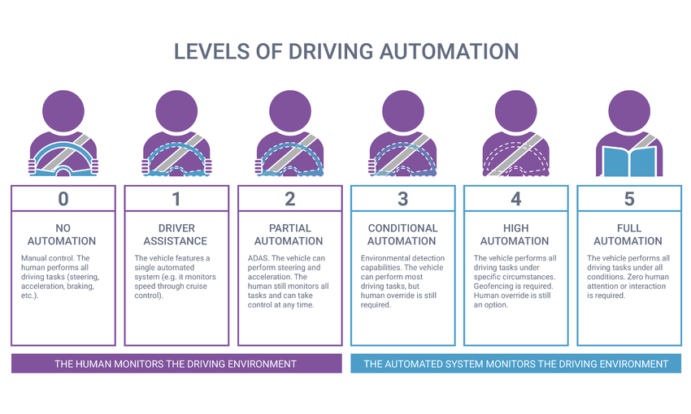
Level of Autonomy
We are still in the level 3 & some companies like Alphabet is working on level 4.
Even Tesla has level 2 and level 4 self driving cars only.ff

Slide 4
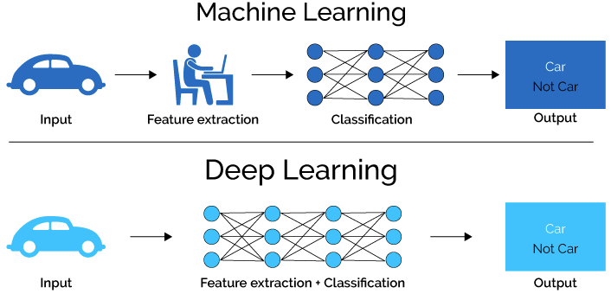
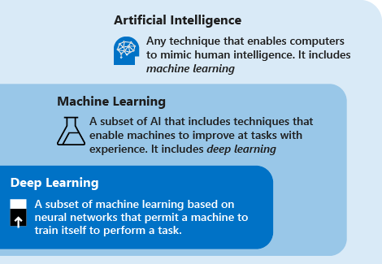
Machine Learning Vs Deep Learning
I’m using the deep learning approach

Slide 5
Requirements
A good quality camera
A huge amount of data for pre-processing
A high computing GPU enabled notebook or PC
A Convolutional Neural Network built from the preprocessed data
Prerequisite of Python Programming Language

Slide 6
Libraries
OpenCV
NumPy
scikit-learn
scikit-image
imutils
matplotlib
TensorFlow 2.0

Slide 7
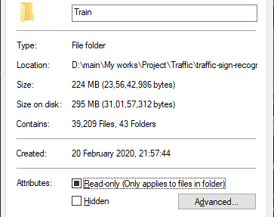
Dataset
I have trained a neural network with a total of 39,209 images with their respective labels and the accuracy I got is 95%.

Slide 8
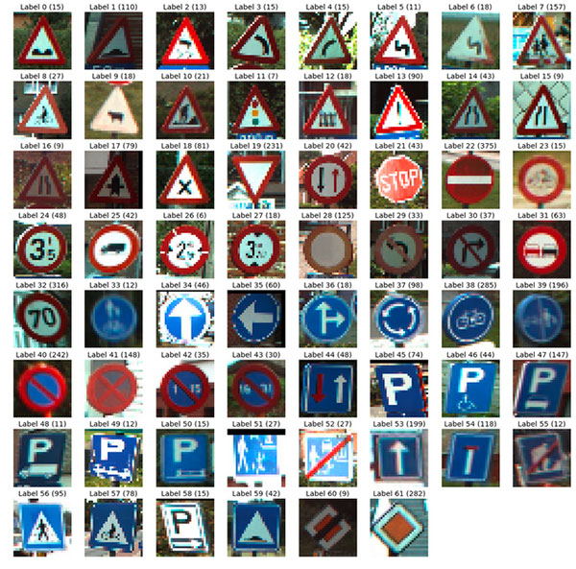
Dataset
To increase the accuracy the amount of dataset should be increased.

Slide 9
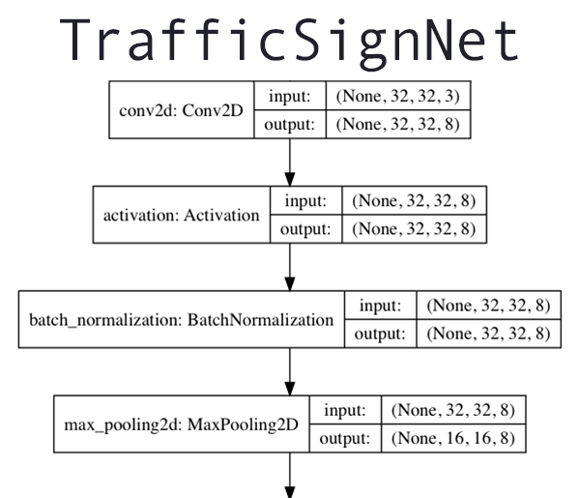
Working

Slide 10
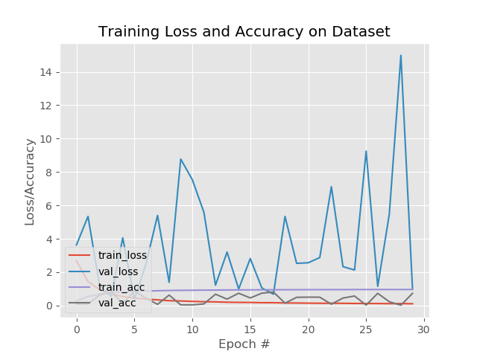
Accuracy Plot
This is the accuracy vs epoch plot of the graph.
In Deep Learning, One epoch is when an entire dataset is passed both forward and backward through the neural network only once.

Slide 11
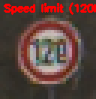
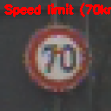
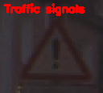
Output
The output is an annotated image of the input image given to our CNN

Slide 12
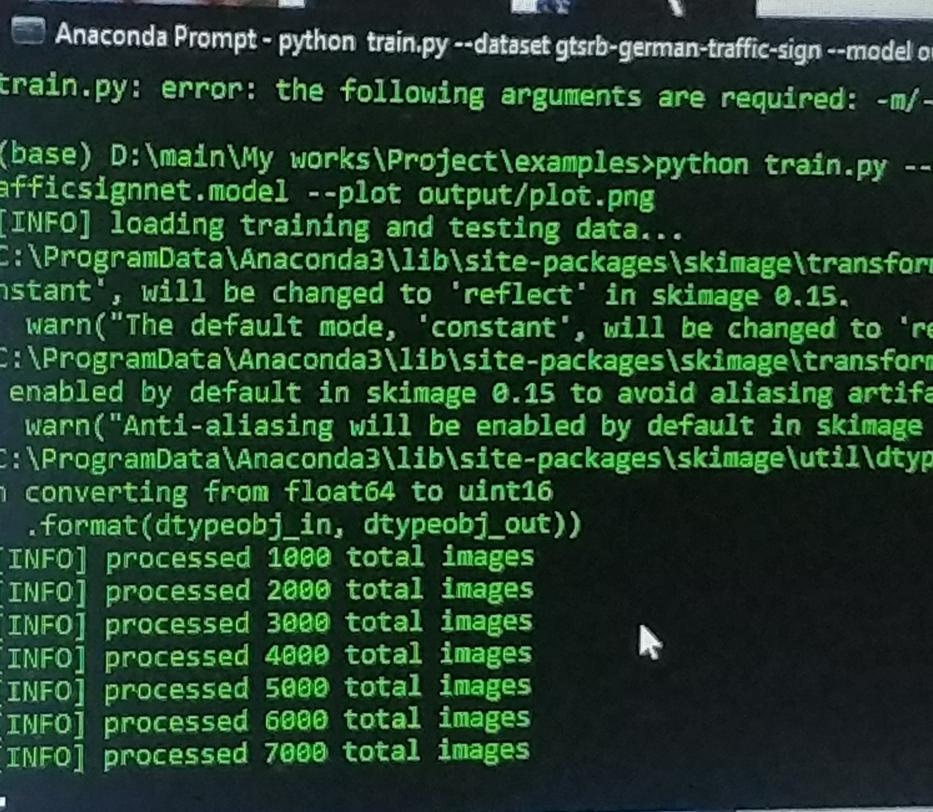
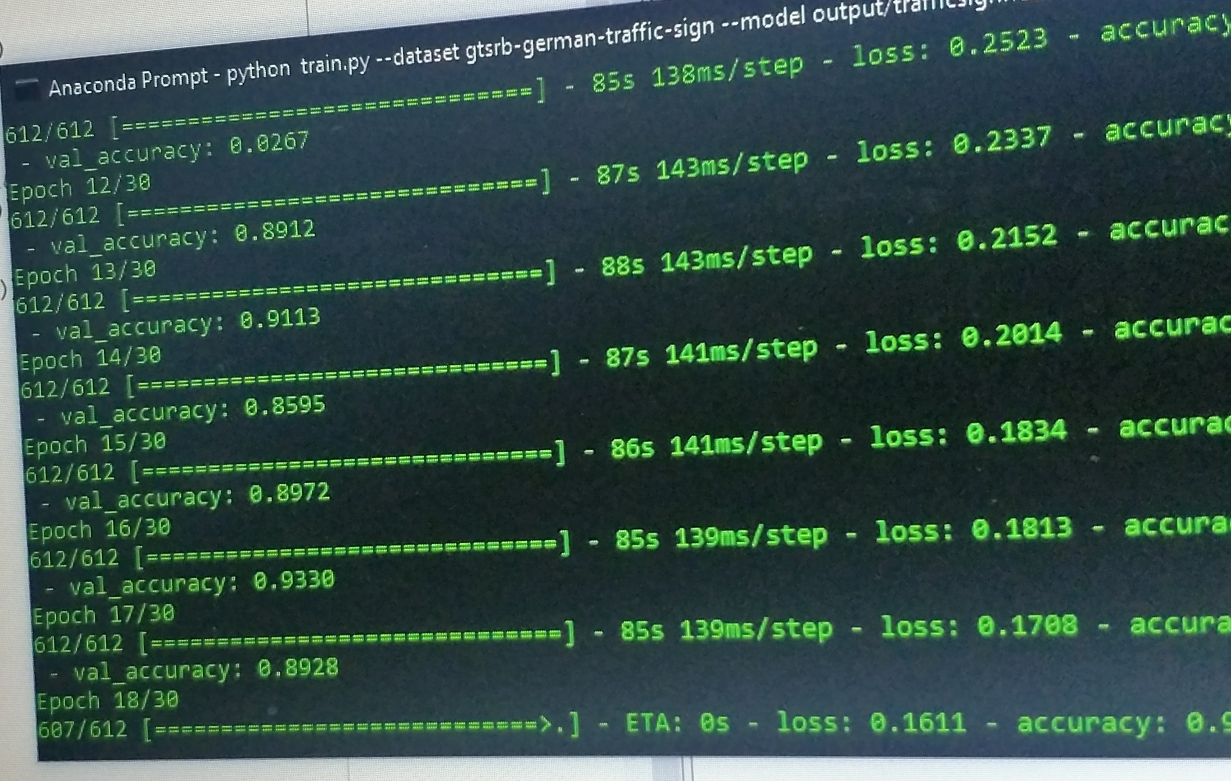
Training the model
Increasing accuracy after each epoch
Pre-processing

Slide 13
Implementation
These annotations can be given as an input to the sensors
For e.g. We get a 70 kmph speed limit annotation we can send the command the actuator for the accelerator
However for an accuracy of 100%, lakhs of images for a single traffic signal for a single traffic signal is needed and a high computing system.
The further implementation of this will be a high res camera which will be useful in detecting the signal as my webcam is just 0.9 MP.

Slide 14
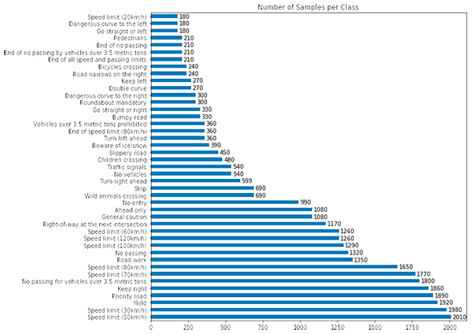
Reference
Dataset is acquired from the famous Kaggle.com website which is actually a German dataset with a total entries of nearly 50,000 images including the train, meta and test set

Slide 15
Reference
Deep Learning Specialization course on COURSERA by Andrew Ng.

Slide 16
THANK YOU

